Slide 1

COMPUTER NETWORKS
S Nagasundari
Department of Computer Science and Engineering

Slide 2

COMPUTER NETWORKS
Unit – 5 Link Layer and LAN Roadmap
Introduction
Error detection, correction
Multiple access protocols
LANs
Addressing, ARP
Ethernet
Switches
A day in the life of a web request
Physical layer
Purpose, Signals to Packets
Analog Vs Digital Signals
Transmission Media
Wireless LANs: IEEE 802.11

Slide 3
COMPUTER NETWORKS
Class 55 : IEEE 802.11- Wireless LAN : Learning Objectives
Why, What- Wireless LAN
802.11 Architecture

Slide 4
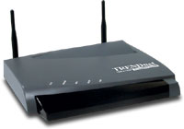
COMPUTER NETWORKS
Wireless LAN
Network connectivity to the legacy wired LAN
Desktop
with PCI 802.11 LAN card
Laptop
with PCMCIA 802.11 LAN card
Provides network connectivity over wireless media
An Access Point (AP) is installed to act as Bridge between Wireless and Wired Network
The AP is connected to wired network and is equipped with antennae to provide wireless connectivity

Slide 5
























COMPUTER NETWORKS
Elements of a Wireless Network
wireless hosts
laptop, smartphone, IoT
run applications
may be stationary (non-mobile) or mobile
wireless does not always mean mobility!
wired network
infrastructure

Slide 6
COMPUTER NETWORKS
Elements of a Wireless Network
wired network
infrastructure

Slide 7
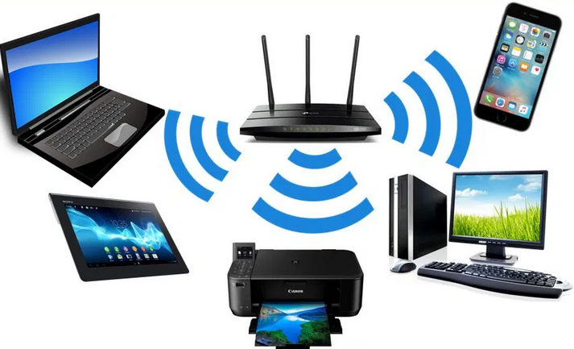
COMPUTER NETWORKS
IEEE 802.11- Wireless LAN
IEEE 802.11 defines
MAC protocol and
Physical medium specification
for wireless LANs

Slide 8

COMPUTER NETWORKS
Elements of a Wireless Network
base station
typically connected to wired network
relay - responsible for sending packets between wired network and wireless host(s) in its “area”
e.g., cell towers, 802.11 access points
wired network
infrastructure

Slide 9
COMPUTER NETWORKS
Elements of a Wireless Network
wireless link
typically used to connect mobile(s) to base station, also used as backbone link
multiple access protocol coordinates link access
various transmission rates and distances, frequency bands
wired network
infrastructure

Slide 10
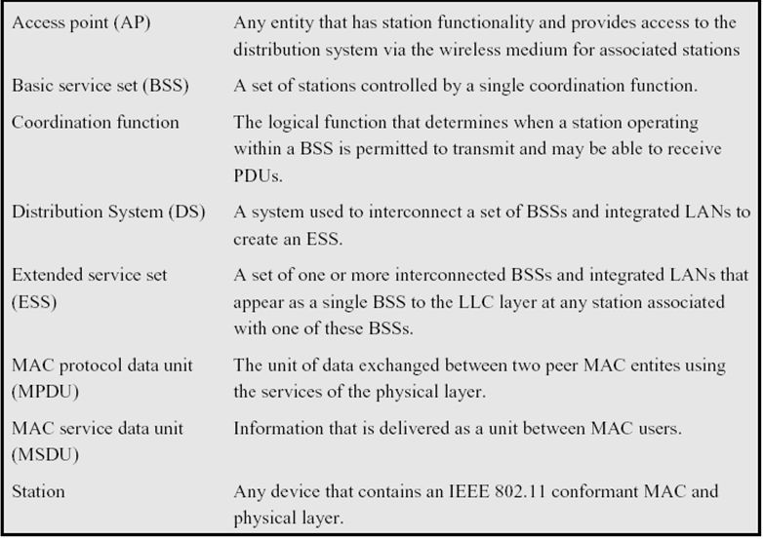
COMPUTER NETWORKS
IEEE 802.11- Terminology

Slide 11
COMPUTER NETWORKS
Characteristics of Selected Wireless Links
14 Gbps
802.11ax
10 Gbps
5G
2 Key Areas:
Coverage area &
Link rate
3.5 Gbps
802.11ac
802.11 af,ah
600 Mbps
802.11n
4G LTE
54 Mbps
802.11g
11 Mbps
802.11b
2 Mbps
Bluetooth
Indoor
Outdoor
Midrange
outdoor
Long range
outdoor
10-30m
50-200m
200m-4Km
4Km-15Km

Slide 12
COMPUTER NETWORKS
Wireless Network
infrastructure mode
base station connects mobiles into wired network
handoff: mobile changes base station providing connection into wired network
wired network
infrastructure

Slide 13
COMPUTER NETWORKS
Wireless Network
ad hoc mode
no base stations
nodes can only transmit to other nodes within link coverage
nodes organize themselves into a network: routing, address assignment, DNS-like name translation, and more.

Slide 14
COMPUTER NETWORKS
Wireless network taxonomy
single hop
multiple hops
host connects to base station (WiFi, cellular) which connects to larger Internet. Eg: 4G LTE
host may have to relay through several wireless nodes to connect to larger
Internet: mesh net
infrastructure
(e.g., APs)
no base station, no connection to larger Internet.
eg: Bluetooth, ad hoc nets
no base station, no connection to larger Internet. May have to relay to reach other.
eg: MANET, VANET
infrastructure less

Slide 15
COMPUTER NETWORKS
IEEE 802.11 Wireless LAN (WiFi)
IEEE 802.11 standard | Year | Max data rate | Range | Frequency
802.11b | 1999 | 11 Mbps | 30 m | 2.4 Ghz
802.11g | 2003 | 54 Mbps | 30m | 2.4 Ghz
802.11n (WiFi 4) | 2009 | 600 | 70m | 2.4, 5 Ghz
802.11ac (WiFi 5) | 2013 | 3.47Gpbs | 70m | 5 Ghz
802.11ax (WiFi 6) | 2020 (exp.) | 14 Gbps | 70m | 2.4, 5 Ghz
802.11af | 2014 | 35 – 560 Mbps | 1 Km | unused TV bands (54-790 MHz)
802.11ah | 2017 | 347Mbps | 1 Km | 900 Mhz
all use CSMA/CA for multiple access, and have base-station and ad-hoc network versions

Slide 16




COMPUTER NETWORKS
The 802.11 LAN architecture
Internet
wireless host communicates with base station
base station = access point (AP)
Basic Service Set (BSS) (aka “cell”) in infrastructure mode contains:
wireless hosts
access point (AP): base station
ad hoc mode: hosts only
switch
or router
BSS 1
BSS 2

Slide 17
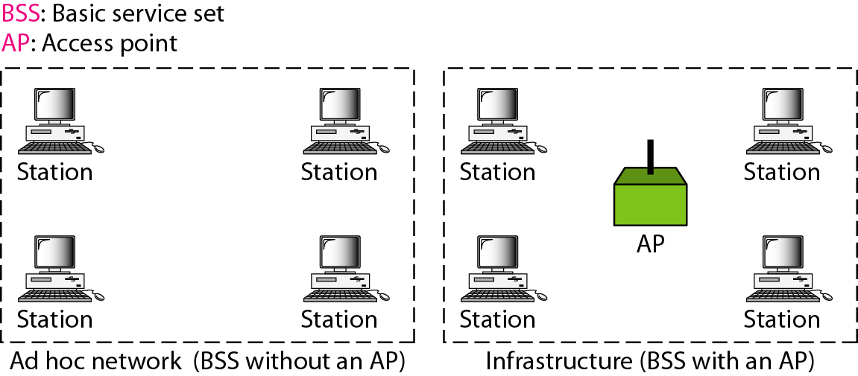
COMPUTER NETWORKS
Basic Service Set
May be isolated or connect to backbone distribution system (DS) through access point (AP)
AP functions as bridge
BSS- Smallest building block
Number of stations
Same MAC protocol
Competing for access to same shared wireless medium

Slide 18
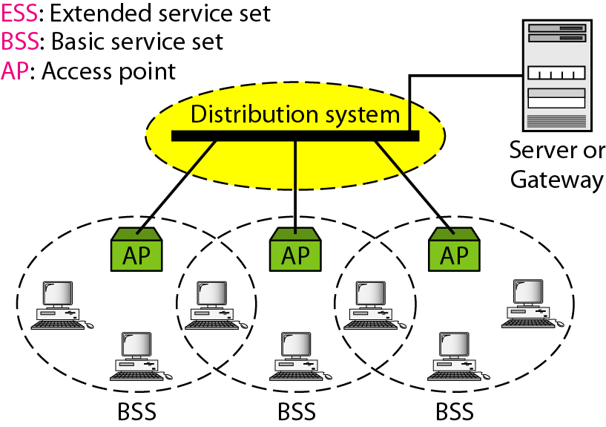
COMPUTER NETWORKS
Extended Service Set
An Access Point (AP) broadcasts SSID (service set identifier) roughly every 100 ms and at 1 Mbps (to accommodate the slowest client)

Slide 19
COMPUTER NETWORKS
802.11: Channels, Association
spectrum divided into channels at different frequencies
AP assigns Service Set ID (SSID)
AP admin chooses frequency for AP (2.4 GHz to 2.4835 GHz)
interference possible: channel can be same as that chosen by neighboring AP! – WiFi Jungle
arriving host: must associate with an AP
scans channels, listening for beacon frames containing AP’s name (SSID) and MAC address
selects AP to associate with
then may perform authentication
then typically run DHCP to get IP address in AP’s subnet
BSS

Slide 20
COMPUTER NETWORKS
802.11 active/passive scanning
BBS 1
BBS 2
BBS 1
BBS 2
1
1
AP 2
AP 1
1
AP 2
2
2
2
AP 1
3
3
4
H1
H1
passive scanning:
beacon frames sent from APs
association Request frame sent: H1 to selected AP
association Response frame sent from selected AP to H1
active scanning:
Probe Request frame broadcast from H1
Probe Response frames sent from APs
Association Request frame sent: H1 to selected AP
Association Response frame sent from selected AP to H1

Slide 21


COMPUTER NETWORKS

Slide 22
THANK YOU
S Nagasundari
Department of Computer Science and Engineering
nagasundaris@pes.edu

